Slide 1
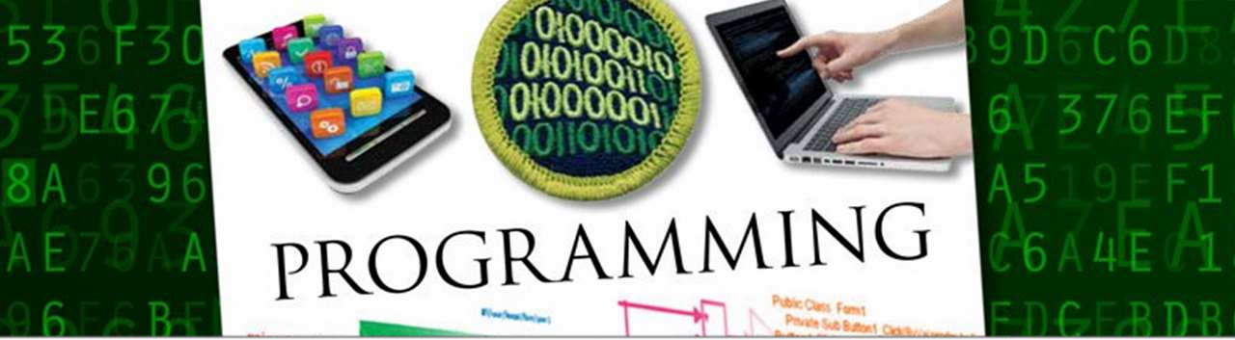


Slide 2
“There are only 10 kinds of people in the world: those who understand binary and those who don’t.”
~ anonymous

Slide 3

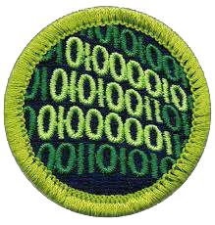

Slide 4


Slide 5

Converting ideas into instructions
[Requirements]
[Design] [Coding]
[Testing]

Slide 6
Real World Programming Example
Notes:
Structured Programming in Everyday Life
1. Sequence Execute a list of statements in order.
Example: Baking BreadAdd flour. Add salt. Add yeast. Mix. Add water. Knead. Let rise. Bake.
2. Repetition Repeat a block of statements while a condition is true.
Example: Washing DishesStack dishes by sink. Fill sink with hot soapy water. While moreDishes Get dish from counter, Wash dish, Put dish in drain rack. End While Wipe off counter. Rinse out sink.
3. Selection Choose at most one action from several alternative conditions.
Example: Sorting MailGet mail from mailbox. Put mail on table. While moreMailToSort Get piece of mail from table. If pieceIsPersonal Then Read it. ElseIf pieceIsMagazine Then Put in magazine rack. ElseIf pieceIsBill Then Pay it, ElseIf pieceIsJunkMail Then Throw in wastebasket. End If End While

Slide 7




1.2 million
2,500

Slide 8
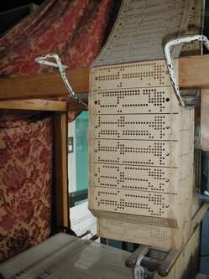
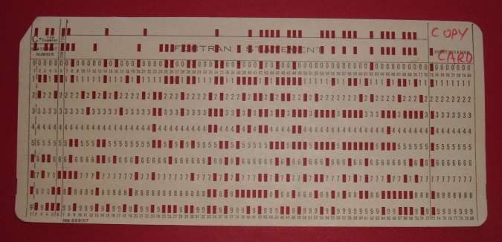
Jacquard Loom
Punch Cards

Slide 9

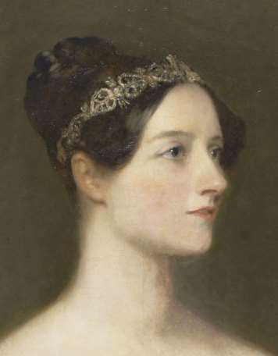


1843

Slide 10
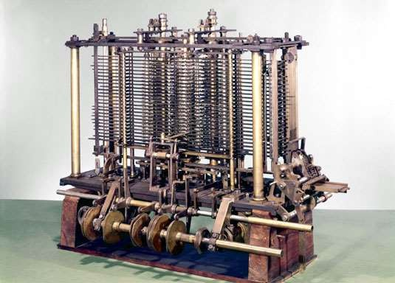

Slide 11








Conditional Control Transfer
<condition> <action a> <action b>
<raining> <stay inside> <go outside>
<condition> <action>
<raining> <hold umbrella>
Programming Pioneer 1903-1957

Slide 12

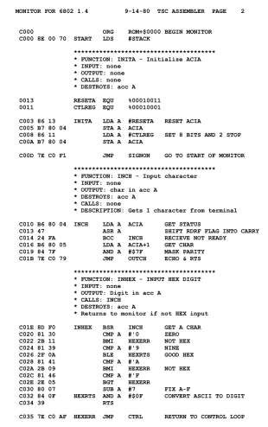
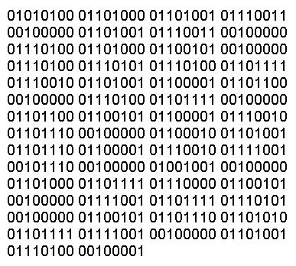
Assembly language is hardware specific and is compiled into machine language (binary code)

Slide 13



Slide 14














1950s
1960s-1970s
BASIC (1964)
FORTRAN (1957)
Pascal (1970)
LISP (1958)
COBOL (1959)
C (1972)

Slide 15


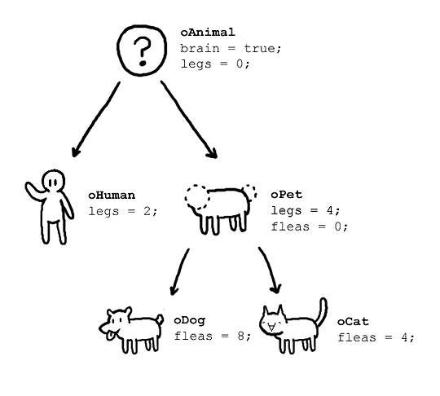








Slide 16








Slide 17






ADA (1980)
Ruby (1993)
Java (1995)
PHP (1995)
JavaScript (1995)
Objective-C (1983)
PERL (1987)
Python (1991)

Slide 18
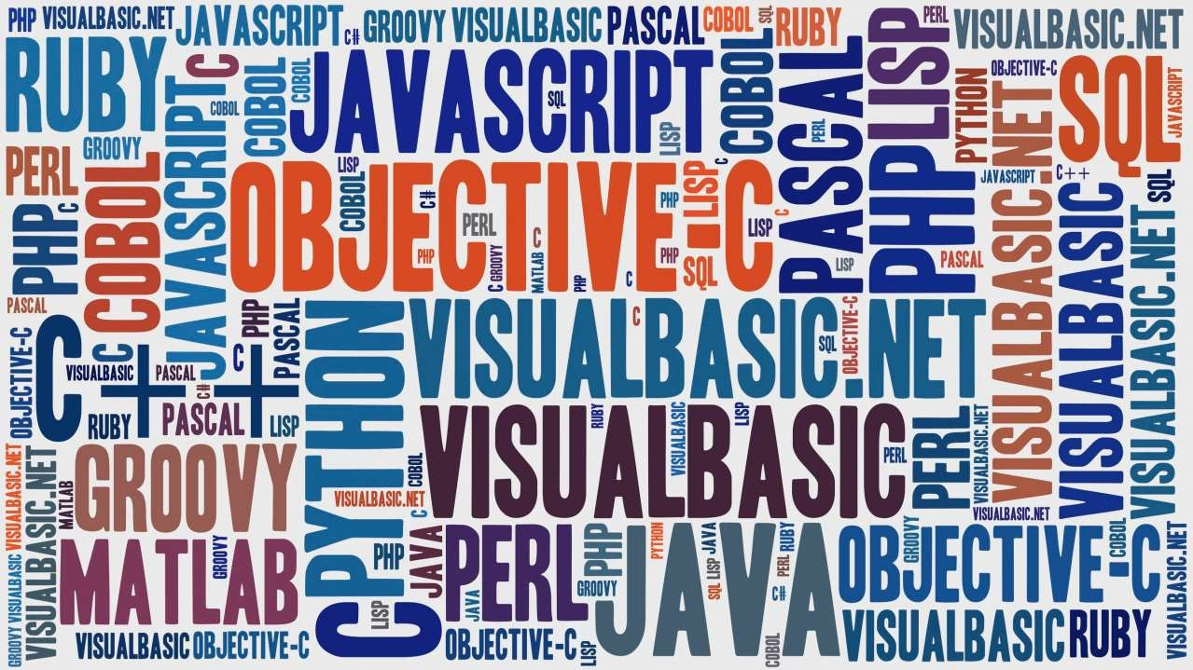

Slide 19
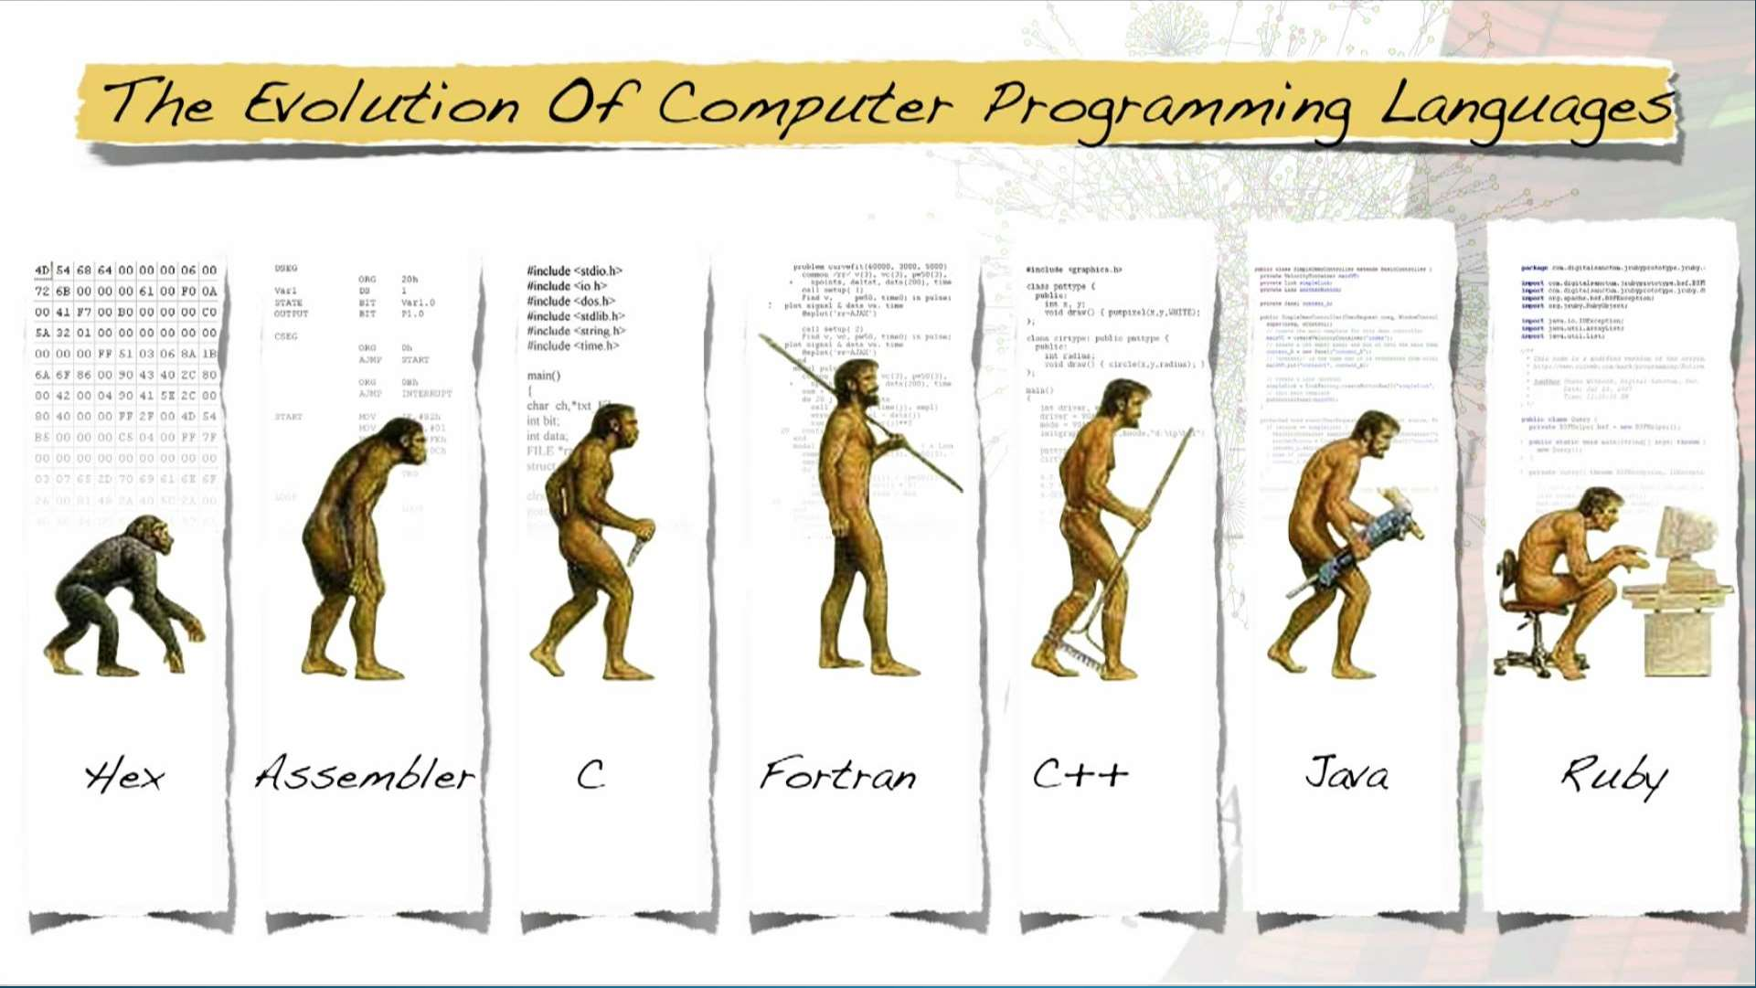

Slide 20


Slide 21


Slide 22





Slide 23


Slide 24










FREEWARE
OPEN SOURCE
SHAREWARE
Open Source Initiative

Slide 25
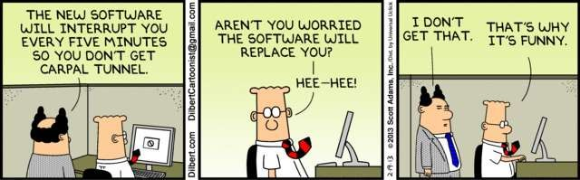







Slide 26
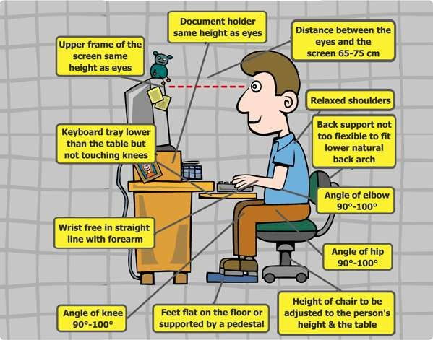

Slide 27



Slide 28






Slide 29



Slide 30















Slide 31












Accounting
Retail
Administrative
Warehouses

Slide 32


Programmable Logic Controller (PLC)

Slide 33








Slide 34





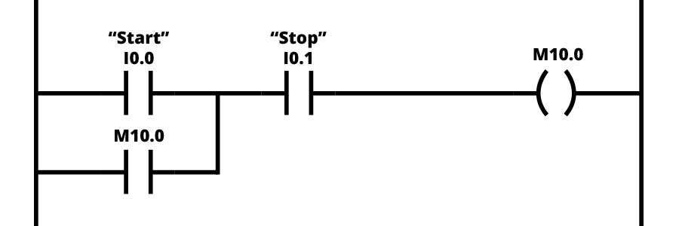

Slide 35
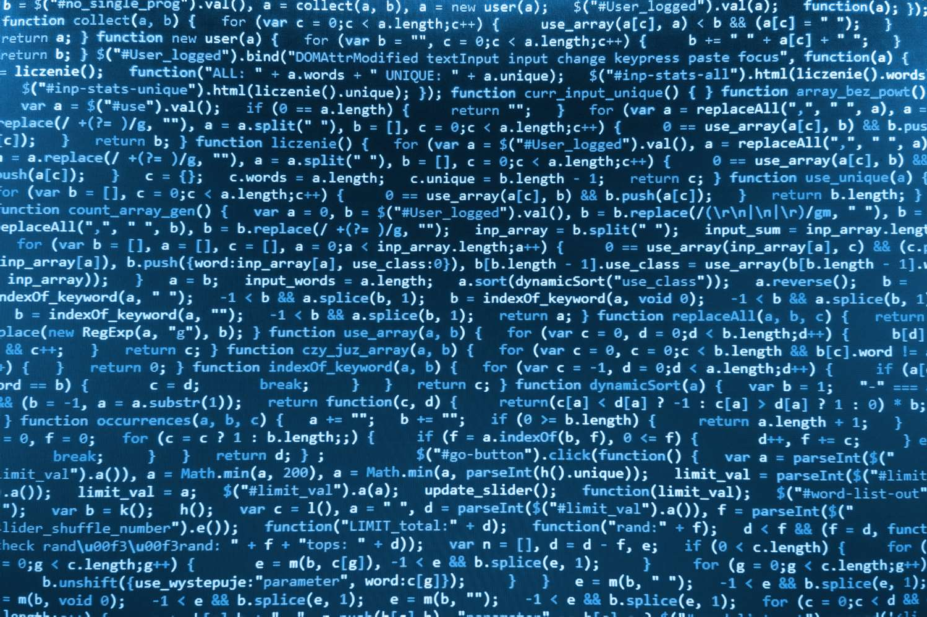






Slide 36


Slide 37
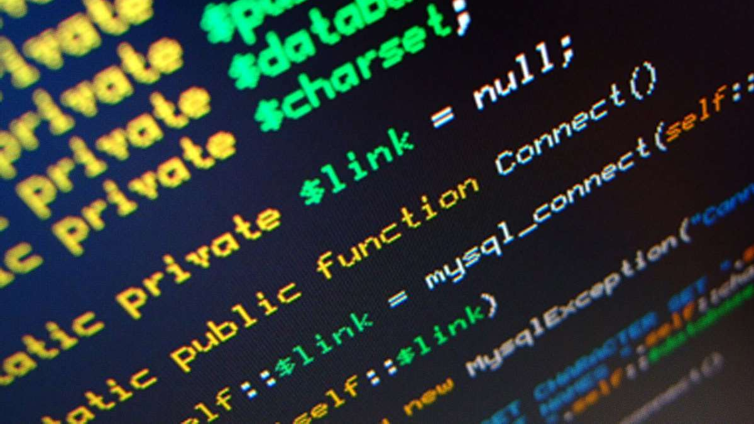







Slide 38

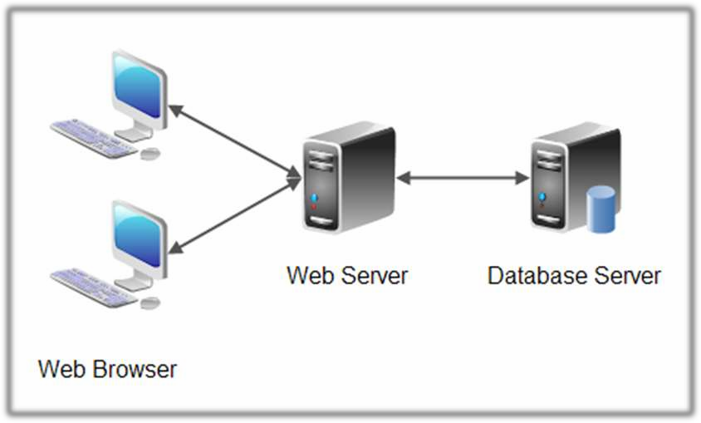

Slide 39

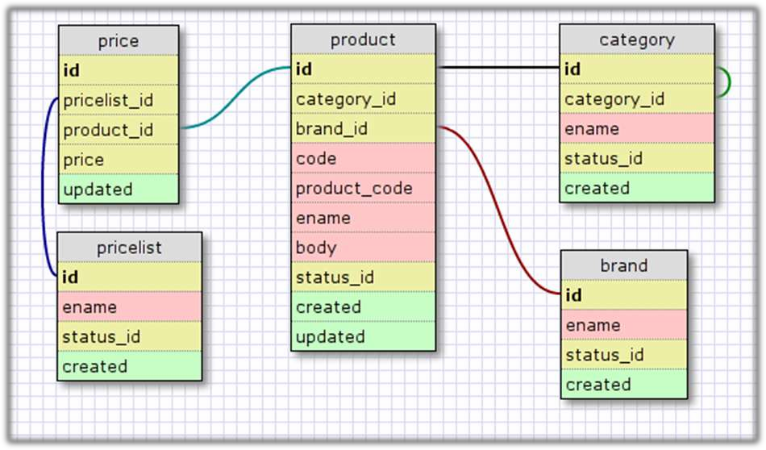

Slide 40
Data Definition Language (DDL)
Data Manipulation Language (DML)
SELECT
INSERT
UPDATE
DELETE

Slide 41





Slide 42


Slide 43
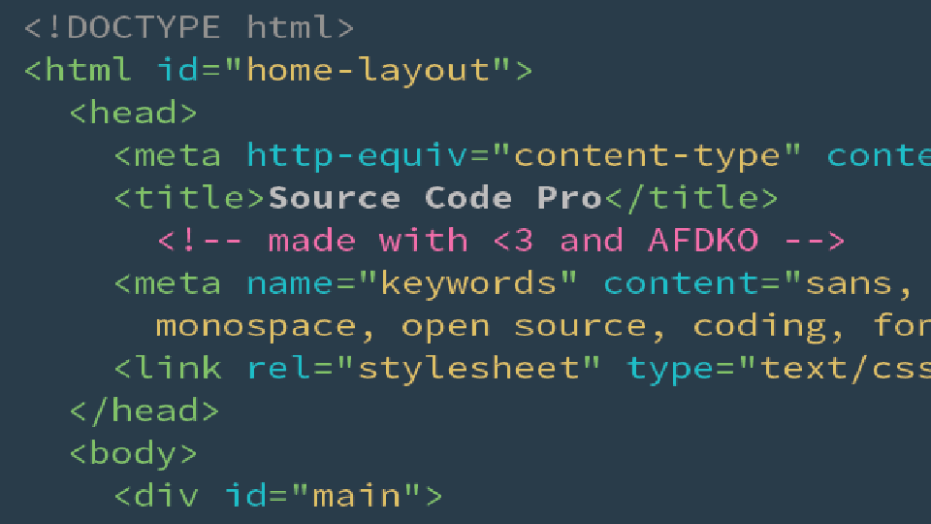
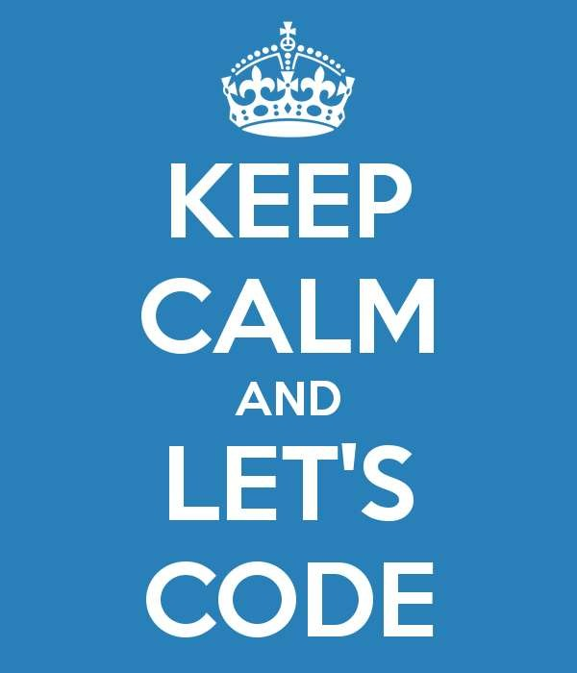

Slide 44

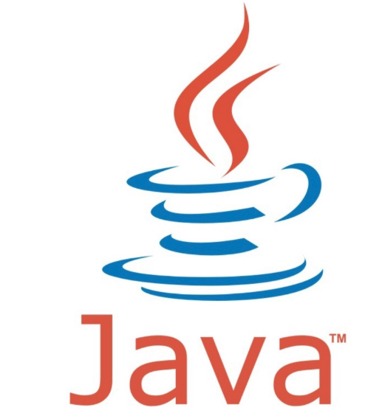

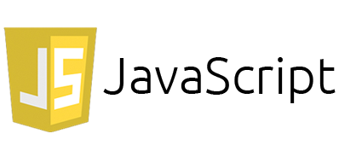

Slide 45
Programming Constructs

Slide 46
Variables
Type variable name and setting value

Slide 47
Arrays
Variable that holds more than 1 pieces of data

Slide 48
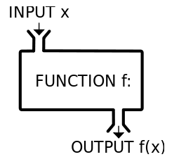
Functions
Re-usable pieces of code

Slide 49
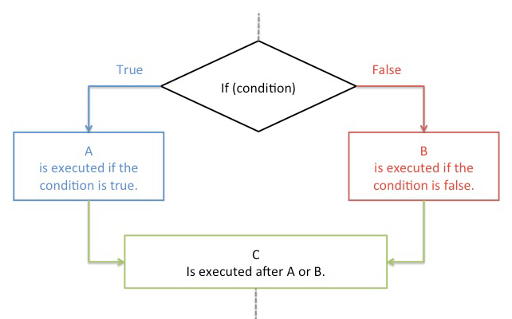
Conditionals
If and Boolean Logic

Slide 50
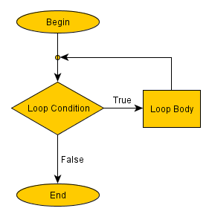
Loops
While/For/Foreach/Do

Slide 51
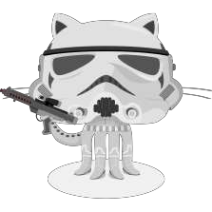


https://github.com/egyptian-bsa

Slide 52







www.codecademy.com www.code.org
www.learnpython.org www.learncpp.com
scratch.mit.edu www.killerphp.com
www.w3schools.com

Slide 53

https://github.com/ericjsilva/programming-mb-python
https://github.com/ericjsilva/programming-mb-php https://github.com/ericjsilva/programming-mb-javascript

Slide 54

Toby Samples toby.samples@gmail.com

